Slide 1

RAM

Slide 2
Table of contents
01
04
02
05
03
06
Introduction
Work
Types
DRAM
SRAM
Thankyou

Slide 3

INTRODUCTION:

Slide 4
RAM stands for random accessed memory
RAM is a read/write memory
Also called main/primary memory
Internal memory of CPU

Slide 5
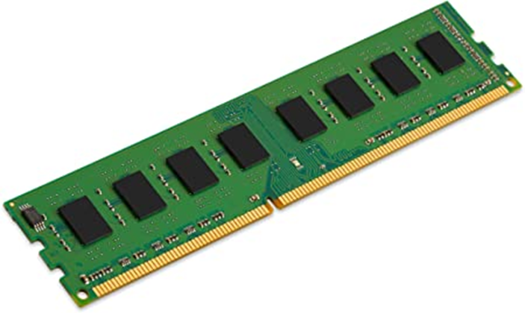
RAM is volatile memory
small, fast and expensive

Slide 6
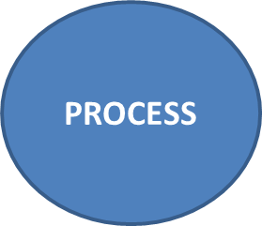






How RAM Works?

Slide 7



TYPES

Slide 8

DRAM
Stands for dynamic random access memory
Consists of transistors and capacitors
Recharged or refreshed
Slower than SRAM
Less expensive
More power consumption
Used as main memory
Memory doesn’t retain its contents
Size of DRAM is 1MB to 16MB

Slide 9

SRAM
Stands for static random access memory
Consists of multiple transistors
No need to refresh
Memory retain its contents
Faster than DRAM
More expensive
Less power consumption than DRAM
used as catche memory
Size is 1GB to 2GB in smart phones and 4GB-16GB in computers

Slide 10

THANKYOU

